Slide 1

Vel Tech Rangarajan Dr. Sagunthala R&D Institute of Science and Technology
School of Computing
Department of Computer Science and Engineering
10211CS224 / FULL STACK APPLICATION DEVELOPMENT (JAVA)
PROJECT REVIEW : MILESTONE PROJECT – 1
Date: 25-03-2026
Relational Inventory Control and Stock Tracking System
SDG: SDG No – SDG Title(Example: SDG 4 – Quality Education)
Presented By:
Kunchapu Vandana– VTU24401–23UECS0788
Courses Handling Faculty:
Dr.S.Hemamalini (TTS4062)

Slide 2
INTRODUCTION
1
2
A Relational Inventory Control and Stock Tracking System is a database-driven solution designed to efficiently manage and monitor inventory levels, stock movements, and product information within an organization. It uses a relational database structure, where data is organized into interconnected tables, ensuring accuracy, consistency, and easy retrieval.
This system helps businesses track stock in real time, reduce manual errors, and optimize inventory levels. By maintaining relationships between entities such as products, suppliers, orders, and transactions, it enables better decision-making and streamlined operations.
It is widely used in retail, manufacturing, warehouses, and distribution sectors to improve efficiency, reduce costs, and ensure that the right products are available at the right time.
3
4
5
6
7
8
9

Slide 3
PROBLEM STATEMENT
1
2
Manual inventory management leads to errors and inefficiency.
Difficulty in tracking real-time stock levels .
Risk of overstocking and stock shortages .
Lack of centralized and organized data system .
Poor visibility of product, supplier, and transaction relationships.
Time-consuming report generation and decision-making.
Need for an accurate, reliable, and automated inventory system.
3
4
5
6
7
8
9

Slide 4
OBJECTIVE(S)
To develop an efficient inventory control and stock tracking system.
To maintain accurate and real-time stock records.
To organize data using a relational database structure.
To reduce manual errors and improve data consistency.
To track product movement, suppliers, and transactions effectively.
To generate quick and reliable reports for decision-making.
To optimize inventory levels and reduce operational costs.
1
2
3
4
5
6
7
8
9

Slide 5
PROPOSED SYSTEM
1
The proposed system is a relational inventory control and stock tracking system using a database to manage inventory efficiently.
It tracks stock in real-time, recording every addition, sale, or movement of items automatically.
The system generates alerts for low stock levels to prevent stockouts and overstocking.
It maintains organized records of suppliers, purchases, and sales for accurate inventory management.
The system produces reports on stock trends, turnover, and valuation to aid decision-making.
It reduces human errors common in manual inventory tracking.
The system is scalable and easy to update, handling large volumes of data efficiently.
Overall, it provides improved accuracy, better resource management, and faster operations compared to traditional systems.
2
3
4
5
6
7
8
9

Slide 6
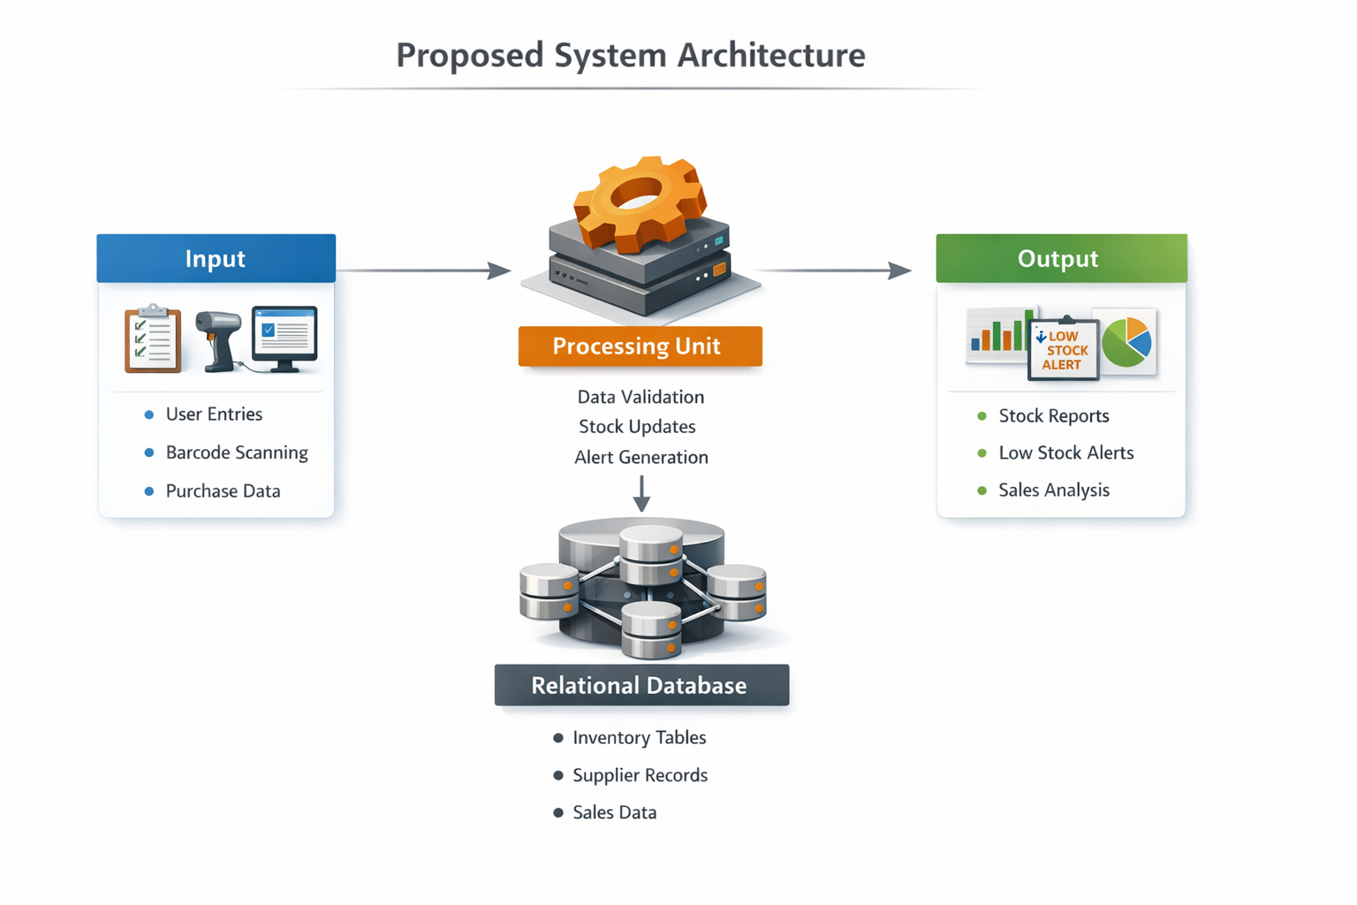
PROPOSED SYSTEM ARCHITECTURE
1
Input: Users enter data related to inventory, such as new stock, sales, purchases, or supplier details. Input can come from forms, barcode scanners, or manual entry. Processing: The system processes input data to update inventory, check stock levels, and calculate stock availability. It generates alerts, validates transactions, and performs necessary calculations automatically. Database: A relational database stores all inventory data in organized tables with defined relationships (e.g., items, suppliers, sales, purchases). Ensures data integrity, easy retrieval, and real-time updates. Output: Provides real-time reports on stock levels, low-stock alerts, purchase summaries, and sales trends. Helps managers make informed decisions and plan procurement efficiently.
2
3
4
5
6
7
8
9

Slide 7
WORKFLOW
1
[User/Input]
|
v
[Processing Unit]
|
v
[Relational Database]
|
v
[Output/Reports]
2
3
4
5
6
7
8
9

Slide 8
TECHNOLOGIES USED
Frontend:
HTML, CSS, JavaScript
Bootstrap or Material UI (for responsive design)
Backend:
PHP / Python (Django/Flask) / Node.js
API integration for real-time updates (optional)
Database:
MySQL / PostgreSQL (Relational Database)
Tools:
Visual Studio Code / PyCharm / Sublime Text
phpMyAdmin / pgAdmin (for database management)
Git / GitHub (version control)
Hardware/Software Requirements:
Hardware: PC/Laptop with at least 4GB RAM, 500GB storage
Software: Web browser, MySQL/PostgreSQL server, Python/PHP runtime environment, Internet connection for updates
1
2
3
4
5
6
7
8
9

Slide 9
MODULE DESCRIPTION
Module 1: User Management
Handles user registration, login, and role-based access control to ensure secure system usage.
Module 2: Inventory Management
Manages stock entries, updates, and deletions; tracks product quantities and movements in real-time.
Module 3: Supplier & Purchase Management
Maintains supplier details, purchase orders, and delivery records to streamline procurement.
Module 4: Sales & Order Management
Processes sales, updates inventory automatically, and tracks order fulfillment.
Module 5: Database Management
Stores and organizes inventory, supplier, and sales data in a relational database, ensuring integrity and easy retrieval.
Module 6: Reporting & Alerts
Generates stock reports, low-stock alerts, and sales analytics for informed decision-making.
1
2
3
4
5
6
7
8
9

Slide 10
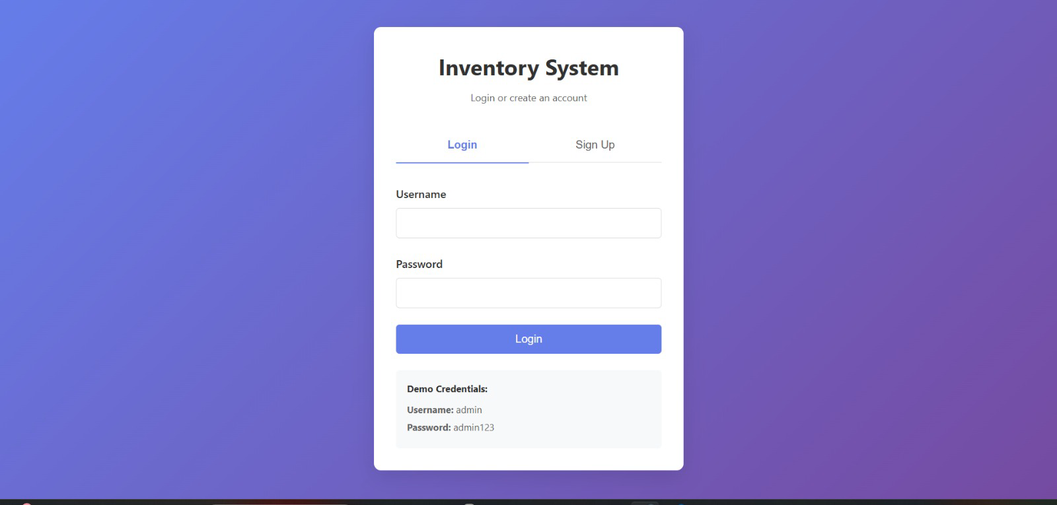
IMPLEMENTATION SCREENSHOTS
1
2
3
4
5
6
7
8
9

Slide 11
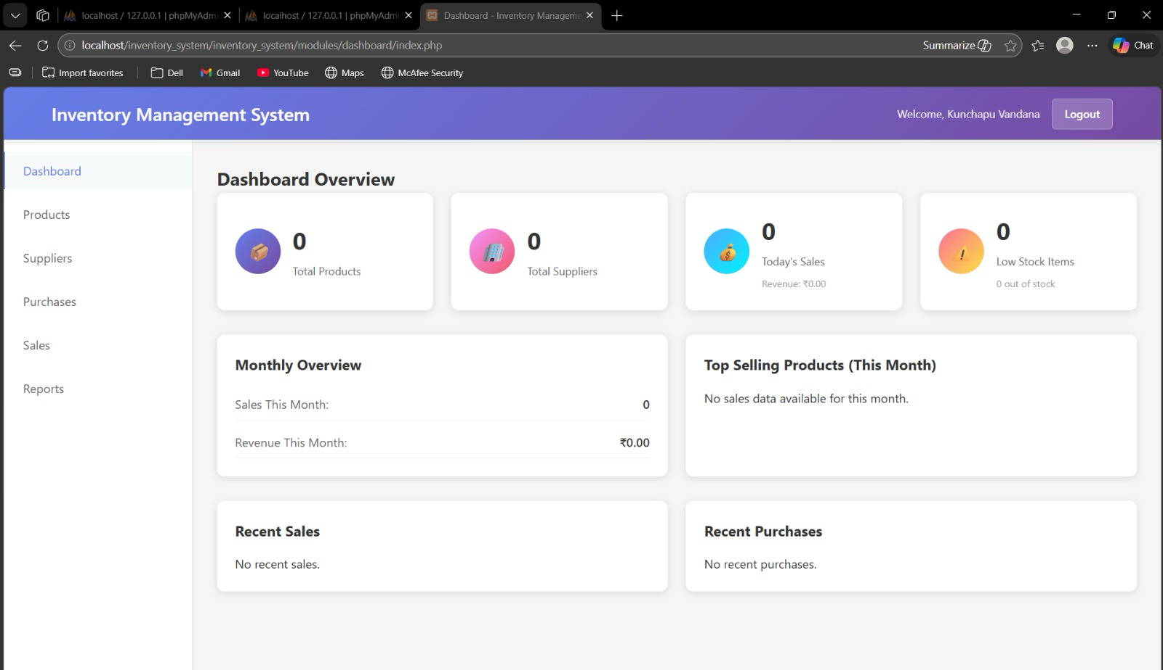
IMPLEMENTATION SCREENSHOTS
1
2
3
4
5
6
7
8(A)
9

Slide 12
ADVANTAGES & LIMITATIONS
Advantages
Real-time Inventory Tracking: Keeps stock levels updated automatically, reducing errors.
Efficient Stock Management: Prevents overstocking and stockouts with alerts for low inventory.
Improved Decision-Making: Generates reports and analytics for better procurement and sales planning.
Time & Cost Saving: Reduces manual work and operational inefficiencies.
Limitations
Initial Setup Cost: Implementation may require investment in software, hardware, and training.
Technical Expertise Required: Users need basic knowledge of the system to operate effectively.
Dependence on Database & System: System failure or database corruption can disrupt operations.
Scalability Challenges: May need upgrades for very large inventories or multiple locations.
1
2
3
4
5
6
7
8
9

Slide 13
Thank you

